Slide 1

High Level Design
Ecommerce Data Analysis & Data Analysis
SANCHIT JAYESH

Slide 2
Document Version Control
Date Issued | Version | Description | Author
23-12-22 | Version 1 | First Version of Ecommerce Dashboard | Sanchit Jayesh

Slide 3
Contents
Document Version Control | 2
Abstract | 4
1. Introduction | 5
1.1 Why this High-Level Design Document? | 5
1.2 Scope | 6
2. General Description | 7
2.1 Product Perspective & Problem Statement | 7
2.2 Tools Used | 8
3. Design Tools | 9
3.1 Functional Architecture | 10
4. Deployment | 11

Slide 4
Abstract
E-commerce (electronic commerce) is the buying and selling of goods and services, or the transmitting of funds or data, over an electronic network, primarily the internet. These business transactions occur either as business-to-business (B2B), business-to consumer (B2C), consumer-to-consumer or consumer-to-business.
Aim of this project is to analyze data of a Ecommerce store to make informed decision.

Slide 5
1. Introduction
1.1 Why this High-Level Design Document?
The purpose of this High-Level Design (HLD) Document is to add the necessary detail to the current project description. This document is also intended to help detect contradictions prior to dashboards and can be used as a reference manual.

Slide 6
1.2 Scope
It can be used to analyze various data of a Ecommerce company and display results on basis of filters. It can be used to make informed business decisions and thus, improve overall performance.

Slide 7
2. General Description
2.1 Product Perspective & Problem Statement
Histogram to analyze number of shipping days
Database keeps track of the various data fields
Sales dashboard to analyze the sales based on various product categories

Slide 8

2.2 Tools Used
Microsoft Excel

Slide 9
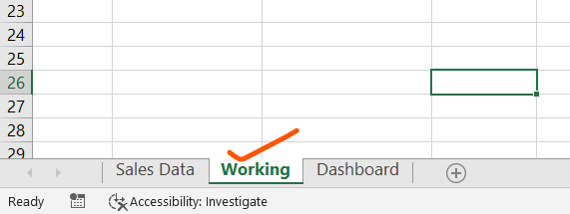
3. Design Details
3.1 Functional Architecture
Dashboard elements fetches data from ‘Working’ worksheet.
Working worksheet contains many important data source such as bins, frequency, month wise sales & profit and region wise sales data

Slide 10
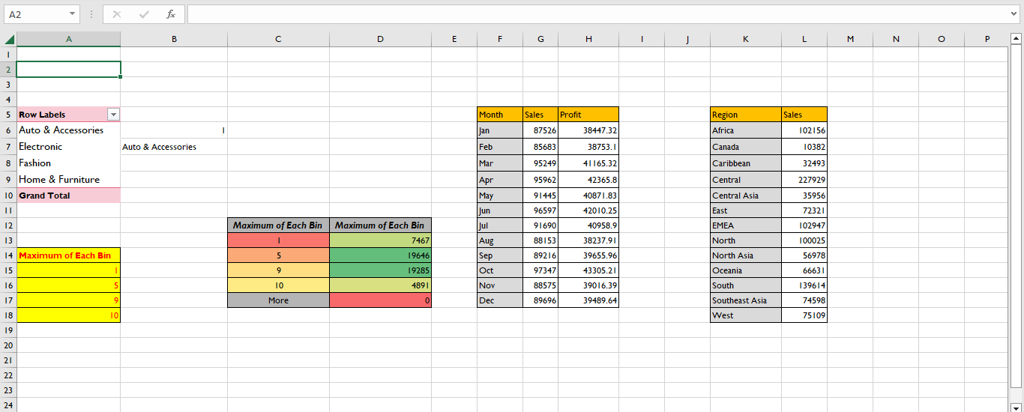

Slide 11
4. Deployment
Dashboard contains different elements including histograms and more, which fetched their data from ‘Working’ worksheet & thus, displays desire results.

